Slide 1

Application Layer – WWW and HTTP
CE3005: Computer Networks
CZ3006: Netcentric Computing
Prof.Mo Li
e-mail: limo@ntu.edu.sg
Location: N4-2b-61
School of Computer Science and Engineering

Slide 2
Application Layer
There are many protocols/applications at the application layer.
Application
layer
Video/audio
skype, Zoom
FTP
file transfer
HTTP protocol
www
UDP
TCP
Transport layer

Slide 3
WWW and HTTP
World Wide Web (WWW) is simply a network application which allows a client to access hypertext file from a server – more than just text – images, sound, links, etc.
Origins: Tim Berners-Lee at CERN proposed the Web in 1989
Purpose: to allow scientists to have access to many databases of documents describing scientific work through their own computers

Slide 4


WWW and HTTP
Web or Internet?
The Internet is a collection of computers and other devices connected by equipment that allows them to communicate with each other
The Web is a collection of software and protocols that run as applications of Internet (e.g., HyperText Transfer Protocol (HTTP), telnet, ftp)

Slide 5
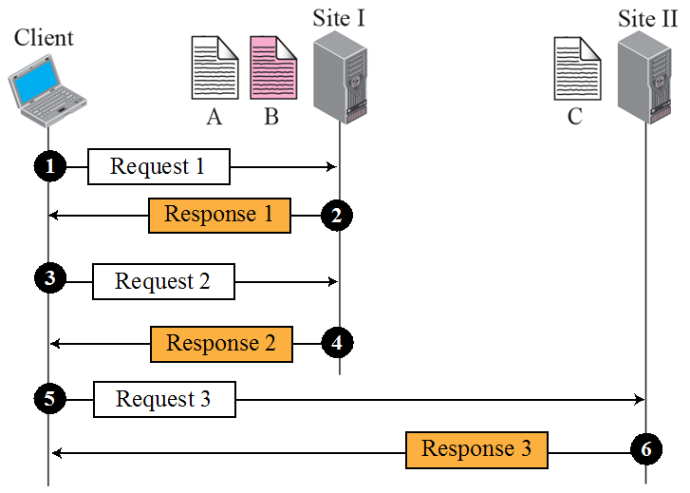
WWW and HTTP
World Wide Web (WWW) allows a client to access a file (hypertext) from a server.
Web servers
Web browser (client)
HyperText Transfer Protocol (HTTP) is the application layer protocol used by WWW. It is designed to run over TCP with server listening at well-known port 80.
Basically, HTTP consists of request/response messages.

Slide 6
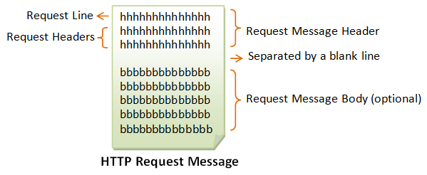
HTTP (Hyper Text Transfer Protocol)
HTTP Request
  Form: HTTP-method doc-path-URL HTTP-version
  Header fields
  blank line
  Message body (optional)

Slide 7
HTTP (Hyper Text Transfer Protocol)
HTTP Request
  Form: HTTP-method doc-path-URL HTTP-version
  Header fields
  blank line
  Message body (optional)
  An example of the first line of a request:
  GET /pub/WWW/TheProject.html HTTP/1.1
Most commonly used methods:
  GET – Fetch a document
  POST – Execute the document, using the data in body (now mainly used for form data processing)
  HEAD – Fetch just the header of the document
  PUT – Store a new document on the server
  DELETE – Remove a document from the server

Slide 8
HTTP (Hyper Text Transfer Protocol)
Common request header fields:
  Accept: text/plain (specify browser’s preference for the type of the requested document)
  Accept: text/*
  If-Modified-Since: date (send the requested document only if it has been modified since the given date)
  Content-Length: number of bytes (for POST request)
  Content-Type: text/html (for POST request)
  ……
Type specifications: type/subtype
  E.g. text/plain, text/html, image/gif, image/jpeg

Slide 9
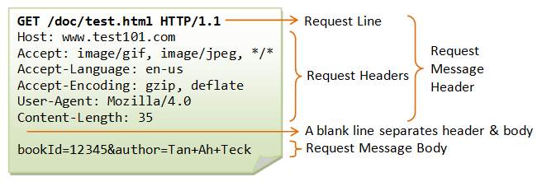
HTTP (Hyper Text Transfer Protocol)

Slide 10
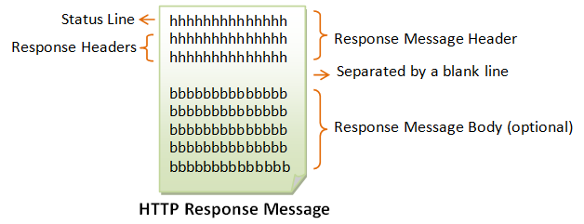
HTTP (Hyper Text Transfer Protocol)
HTTP Response
  Form: Status line
  Response header fields
  blank line
  Response body (optional)

Slide 11
HTTP (Hyper Text Transfer Protocol)
HTTP Response
  Form: Status line
  Response header fields
  blank line
  Response body (optional)
  Status line format:
  HTTP-version status-code explanation
    Example: HTTP/1.1 200 OK
    Status code is a three-digit number

Slide 12
100 Continue: The server received the request and in the process of giving the response.
200 OK: The request is fulfilled.
301 Move Permanently: The resource requested for has been permanently moved to a new location. The URL of the new location is given in the response header called Location. The client should issue a new request to the new location.
302 Found & Redirect (or Move Temporarily): Same as 301, but the new location is temporarily in nature. The client should issue a new request, but applications need not update the references.
304 Not Modified: In response to the If-Modified-Since conditional GET request, the server notifies that the resource requested has not been modified.
400 Bad Request: Server could not interpret or understand the request, probably syntax error in the request message.
401 Authentication Required: The requested resource is protected, and require client’s credential (username/password).
403 Forbidden: Server refuses to supply the resource, regardless of identity of client.
404 Not Found: The requested resource cannot be found in the server.
405 Method Not Allowed: The request method used, e.g., POST, PUT, DELETE, is a valid method. However, the server does not allow that method for the resource requested.
408 Request Timeout:
414 Request URI too Large:
500 Internal Server Error: Server is confused, often caused by an error in the server-side program responding to the request.
501 Method Not Implemented: The request method used is invalid (could be caused by a typing error, e.g., "GET" misspell as "Get").
502 Bad Gateway: Gateway indicates that it receives a bad response from the upstream server.
503 Service Unavailable: Server cannot response due to overloading or maintenance. The client can try again later.
504 Gateway Timeout: Gateway indicates that it receives a timeout from an upstream server.

Slide 13
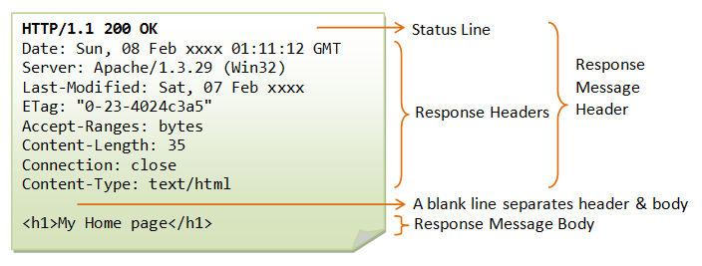

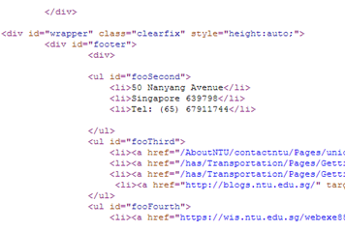
HTTP (Hyper Text Transfer Protocol)

Slide 14
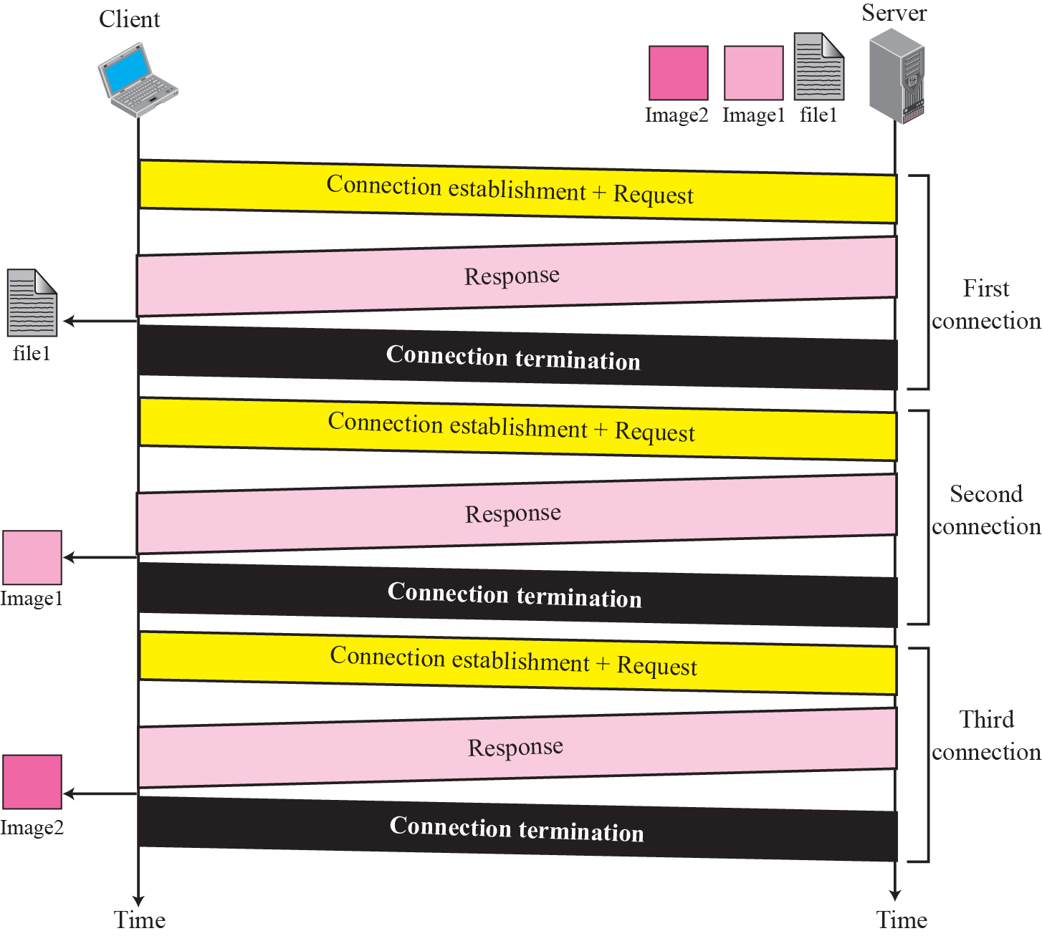
Non-persistent HTTP: individual TCP connection/ termination for each pair of request/response to access one file – inefficient.

Slide 15
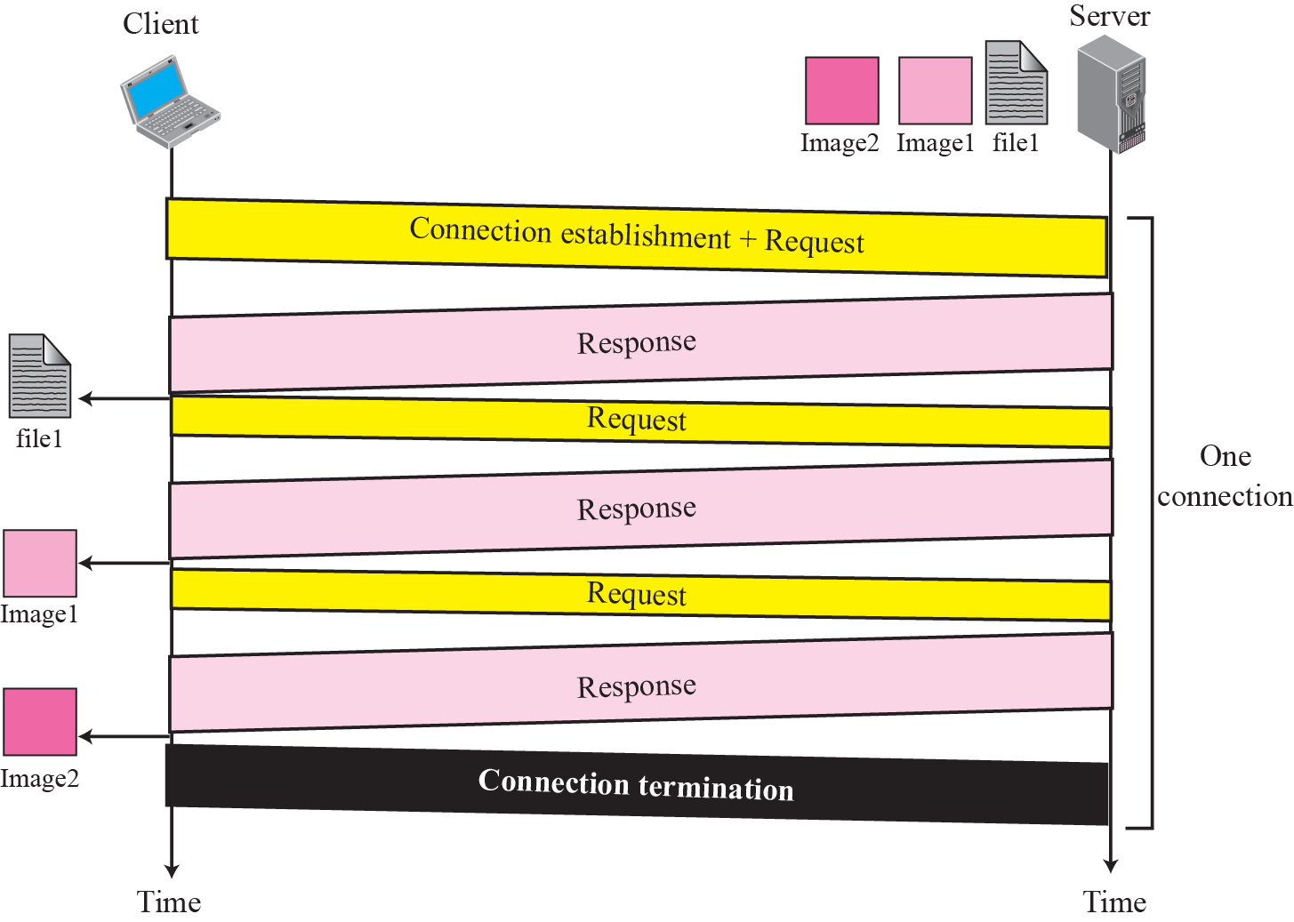
Persistent HTTP: multiple request/response messages within one TCP connection – efficient for accessing multiple files in the same server.

Slide 16
Implementing a simple Web Client:
import java.net.*;
import java.io.*;
import javax.swing.*;
class WebClient
{
public static void main(String args[])
{
String webServer = “www.ntu.edu.sg”;
int httpPort = 80;
Socket sock;
try
{
// Opening a connection to the web server
sock = new Socket(webServer, httpPort);
// Constructing HTTP request header
StringBuffer strToSend = new StringBuffer("");
strToSend.append("GET / HTTP/1.1\r\n");
strToSend.append(“Host: “+webServer+”\r\n");
strToSend.append(“Connection: close\r\n");
strToSend.append("\r\n");
// Sending HTTP request
System.out.println(“Sending a GET request ...\n”);
byte [] outByte = strToSend.toString().getBytes();
sock.getOutputStream().write(outByte);
JAVA Socket Programming
Constructing HTTP header
Sending HTTP request

Slide 17
Implementing a simple Web Client (cont)
// Receiving HTTP response
byte inByte[] = new byte[1024];
StringBuffer inBuffer = new StringBuffer("");
while(true)
{
int numBytes = sock.getInputStream().read(inByte,0,1024);
if (numBytes<0) break;
// Storing receiving texts into a buffer
String str = new String(inByte,0,numBytes);
inBuffer.append(str);
}
// Removing HTTP response header
int idx = inBuffer.indexOf(“\r\n\r\n");
String htmlStr = inBuffer.substring(idx+4);
// Display HTML page received
Jframe frame = new Jframe(“SimpleWebClient”);
frame.setDefaultCloseOperation(WindowConstants.DISPOSE_ON_CLOSE);
JEditorPane pane = new JEditorPane(“text/html”, htmlStr);
frame.getContentPane().add(new ScrollPane(pane));
frame.setSize(600,400);
frame.setVisible(true);
}
catch(Exception e) {};
}
}
Receiving HTTP response
Removing HTTP header (should interpret accordingly)

Slide 18
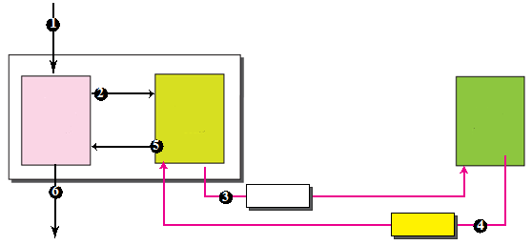
Domain Name System (DNS)
Given only the domain name of a server, how does a client know the IP address to send to destination?
e.g, www.ntu.edu.sg
DNS – to resolve domain name to IP address
name
name
DNS client
DNS server
client
IP addr
query
IP addr
reply
DNS protocol is designed to run over UDP with server
listening at well-known port 53.

Slide 19
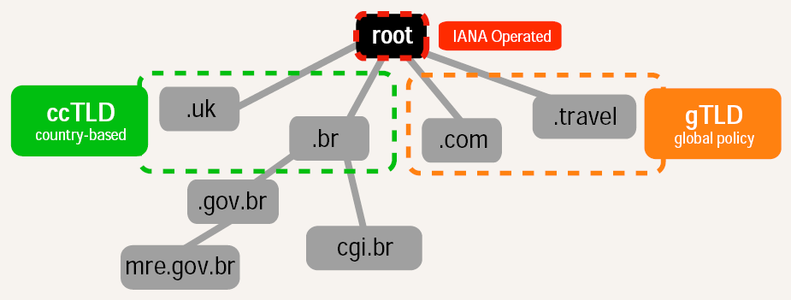
Domain names are divided into gTLDs and ccTLDs, and commercial domain name registrars are accredited to sell them:
generic Top-Level Domains (gTLDs): only IANA/ICANN-
accredited registrars are able to sell domain names under
gTLDs
country-code Top-Level Domains (ccTLDs): delegated to
respective countries, e.g. only (Singapore) SGNIC-
accredited registrars can sell domain names under .sg

Slide 20
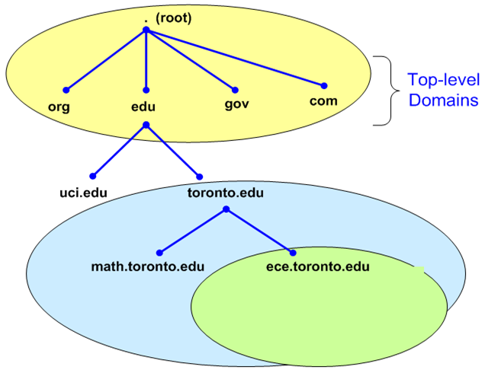
For scalability, domain names are designed to be hierarchical; e.g. ece.toronto.edu
3rd level
2nd level
top level
Top-level domains are managed by IANA
Below top-level domains, management of name space is delegated to respective organizations
Each organization can delegate further
Managed by UofT
Managed by ECE of UofT
Notes:
Work from right to left in the url, equivalent to moving down the hierarchy.

Slide 21
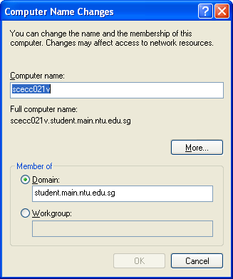
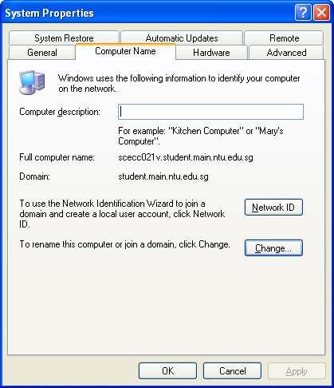
A fully qualified domain name (FQDN) is a completely specified domain name consisting of a host name and a domain.
Eg. configuring domain name in Windows:
host name
FQDN
domain

Slide 22
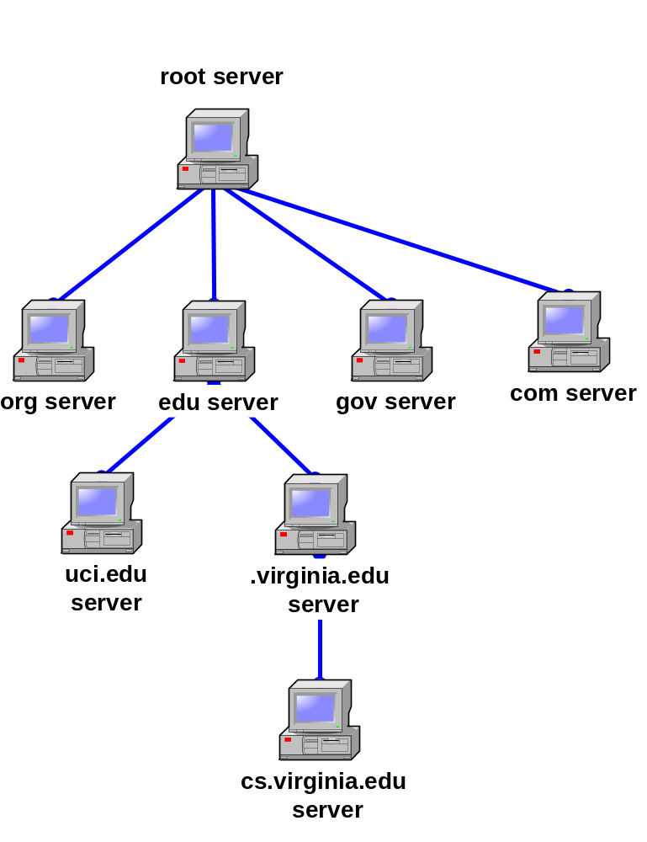
Following the hierarchy of domain names, a hierarchy of name servers are set up to provide DNS services.
Each server is responsible (authoritative) for a zone of the DNS namespace.
A zone can be a node; e.g. edu server is authoritative for xxx.edu
A zone can also consist of multiple nodes; e.g. virginia.edu server is authoritative for xxx.virginia.edu, including xxx.cs.virginia.edu
zone
zone

Slide 23
To be fault tolerant, there are 13 root name servers which are configured to know the authoritative servers for TLDs.
Domain Name Operator IP Address
a.root-servers.net VeriSign 198.41.0.4
b.root-servers.net USC-ISI 192.228.79.201
c.root-servers.net Cogent Communications 192.33.4.12
d.root-servers.net University of Maryland 128.8.10.90
e.root-servers.net NASA 192.203.230.10
f.root-servers.net Internet Systems Consortium 192.5.5.241
g.root-servers.net US DoD 192.112.36.4
h.root-servers.net US Army Research Lab 128.63.2.53
i.root-servers.net Autonomica Stockholm 192.36.148.17
j.root-servers.net VeriSign 192.58.128.30
k.root-servers.net RIPE London 193.0.14.129
l.root-servers.net ICANN Los Angeles 199.7.83.42
m.root-servers.net WIDE Tokyo 202.12.27.33

Slide 24
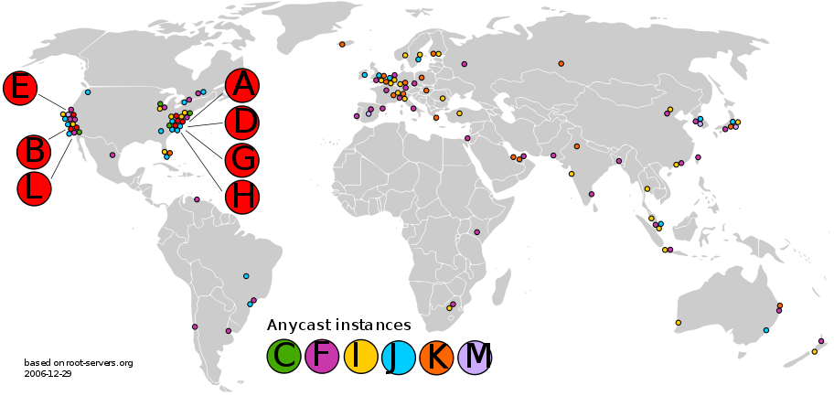
In reality, there are more than 13 physical root name servers through the use of anycast.
Anycast – a group of servers are identified by the same IP address, and packets are routed to the nearest servers

Slide 25
Now, we are ready to understand how it works for internet applications:
To reach an Internet resource, we need to specify:
Method/Protocol used (application layer)
Host using IP address or domain name (network layer)
Port number (or none if using default well-known port) (transport layer)
Path and document name (application layer)
In practice, all above are concatenated into a single string called Uniform Resource Locator (URL)
For example:

Slide 26
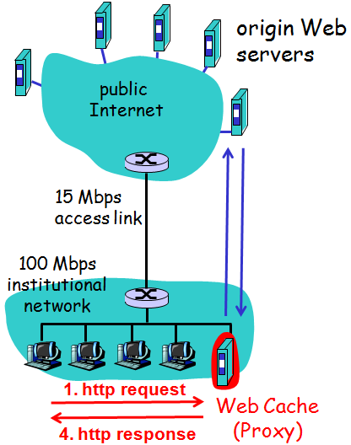
Web Proxy (Cache)
Why Web Proxy?
Improve performance by caching
Reduce traffic load on costly access link
Monitor/Filter contents
How Web Proxy Works?
Client requests to proxy
(if content not available) proxy requests to origin server
Origin server responds to proxy
Proxy responds to client
2. http request
3. http response

Slide 27
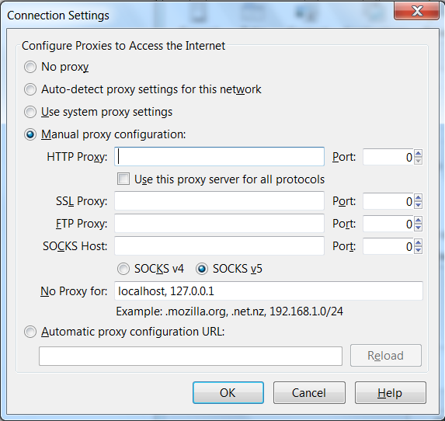
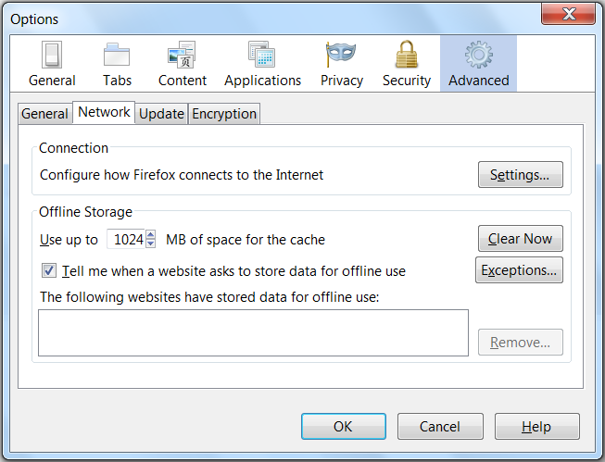
Traditionally, Web proxy is implemented by requiring users to explicitly configure their browsers.

Slide 28
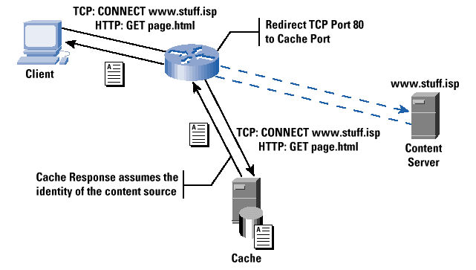
However, note that Web proxy can be implemented transparently without the knowledge of users/servers!
Basically, the organization/ISP configures its routers to intercept all Web traffic and re-direct (mis-direct) them to its Web proxy, which masquerades as the destination server!

Slide 29
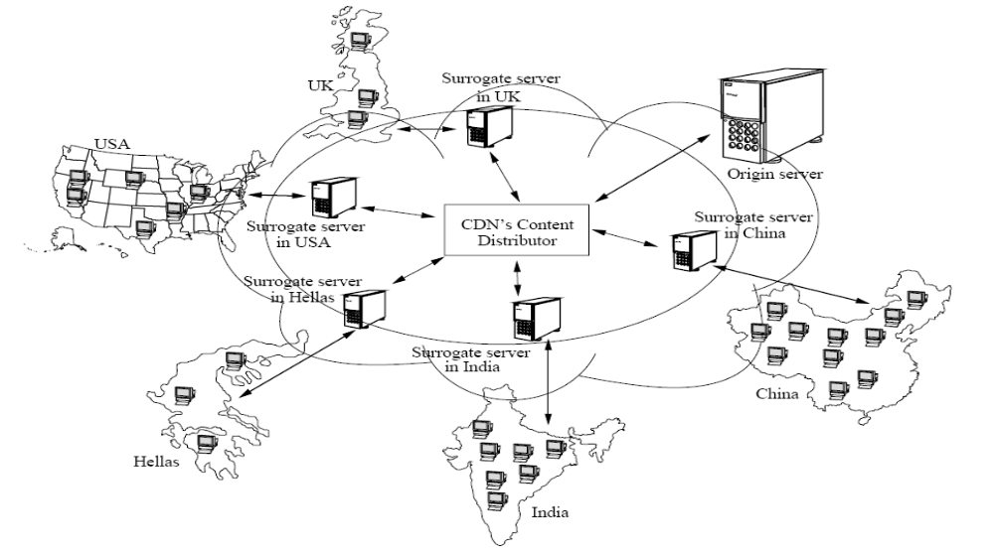
Alternatively, if performance is important, an option for content provider is to use the service of Content Delivery/ Distribution Network (CDN).
a.k.a. edge server

Slide 30


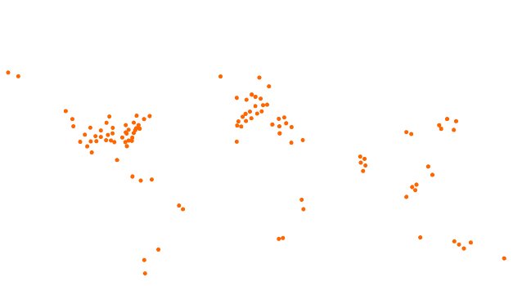
For example, one of the world’s largest CDN is Akamai network.
The Akamai CDN (2011):
85,000+
Servers
950+
Networks
660+ Cities
70+
Countries
Resulting in traffic of:
5.4 petabytes / day
790+ billion hits / day
436+ million unique clients IPs / day

Slide 31
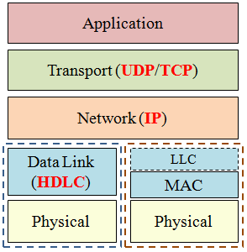
Finally, a review of what we have covered in this course:
WAN
LAN

